Slide 1
Machine Learning in Chemistry
Instructor: Prof. Tzuhsiung (Nick) Yang
Email: tyang@mx.nthu.edu.tw
Time: M5/6
Room: NTHU Library Comp Lab II
Notes:
Rafael Gomez

Slide 2
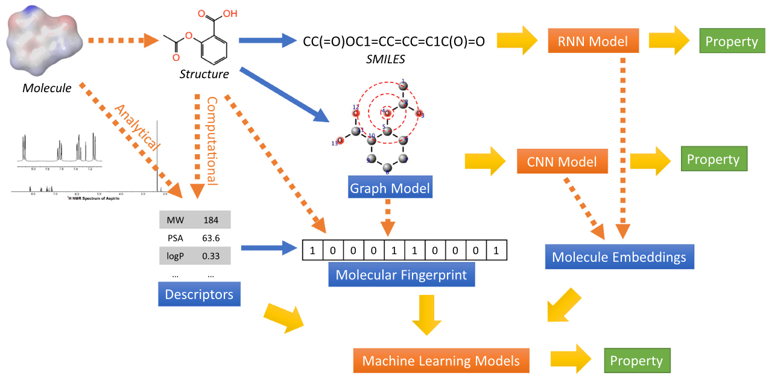
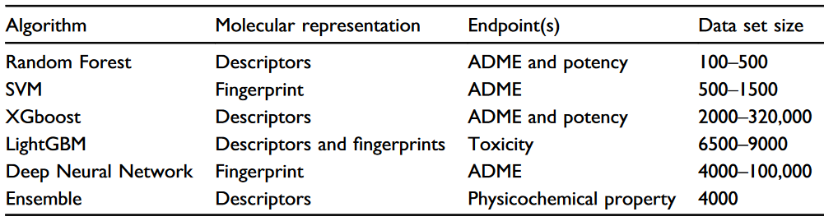
Machine learning Models
Choudhary, K.; DeCost, B.; Chen, C.; Jain, A.; Tavazza, F.; Cohn, R.; Park, C. W.; Choudhary, A.; Agrawal, A.; Billinge, S. J. L.; Holm, E.; Ong, S. P.; Wolverton, C. Recent Advances and Applications of Deep Learning Methods in Materials Science. npj Comput Mater 2022, 8 (1), 1

Slide 3
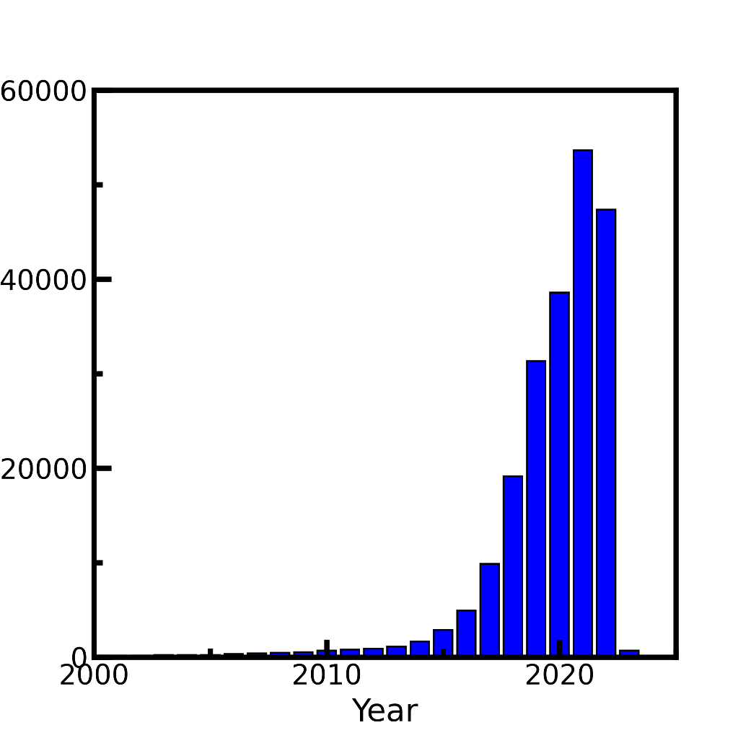

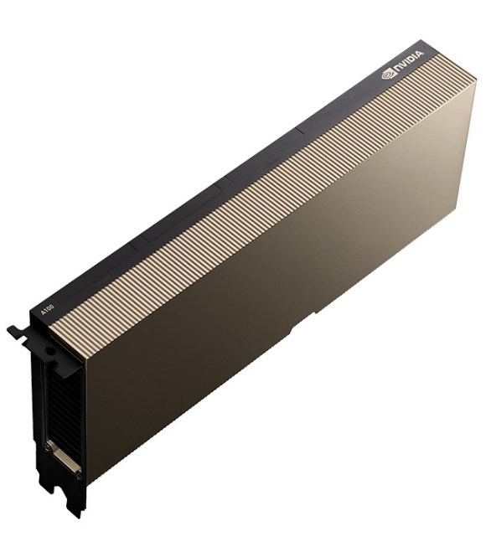
Game changed in 2009
#Publication mentioning deep learning
CUDA introduced in 2007
Publication counts: Web of science, keyword=‘Deep learning’. Accessed on 2022/11/22

Slide 4


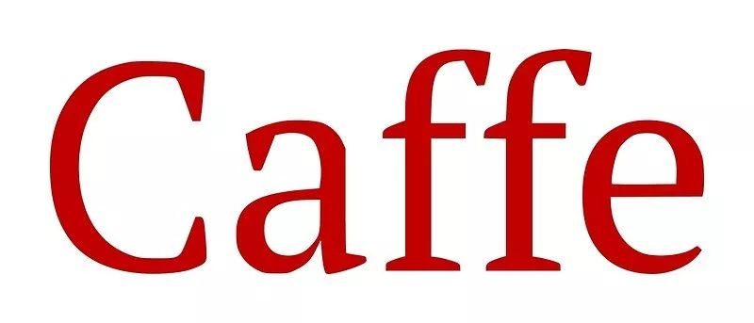


Deep Learning Framework

Slide 5
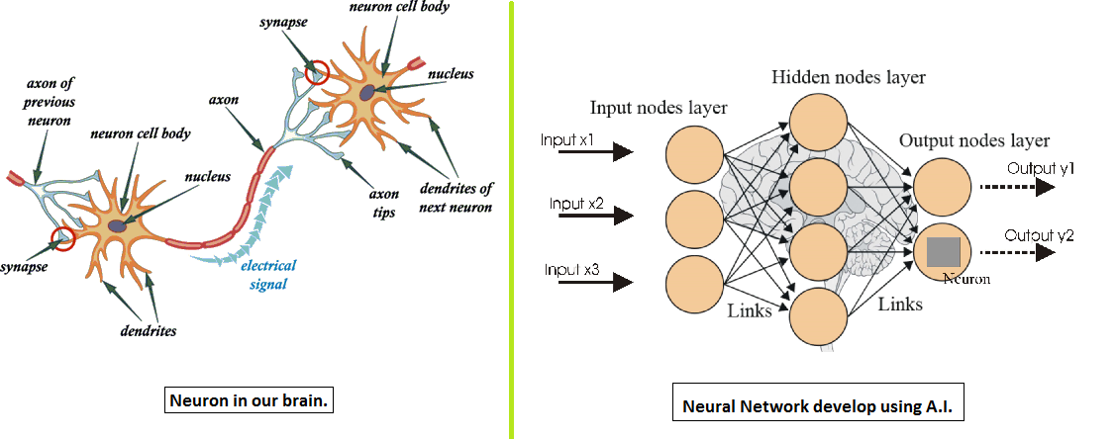
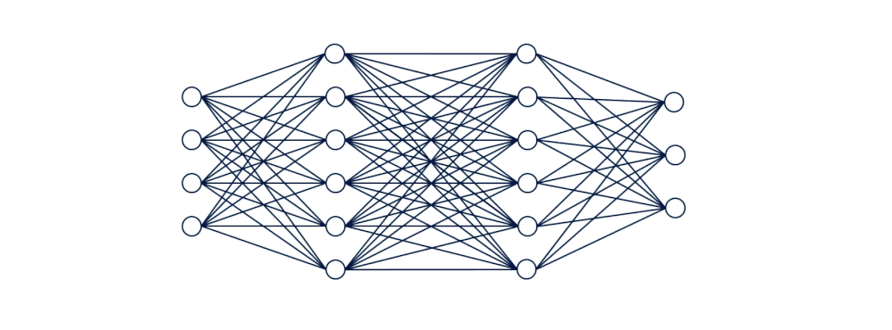
Artificial Neural Network (ANN)

Slide 6
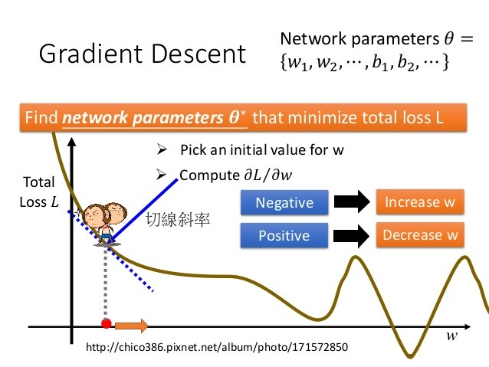

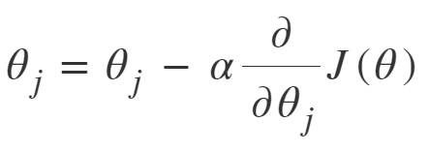
Gradient descent
Gradient descent is an optimization algorithm used in machine learning to minimize the loss or error of a model. It iteratively adjusts the model's parameters by taking steps proportional to the negative gradient of the loss function. It aims to find the optimal values that minimize the error and improve model performance.
slope

Slide 7
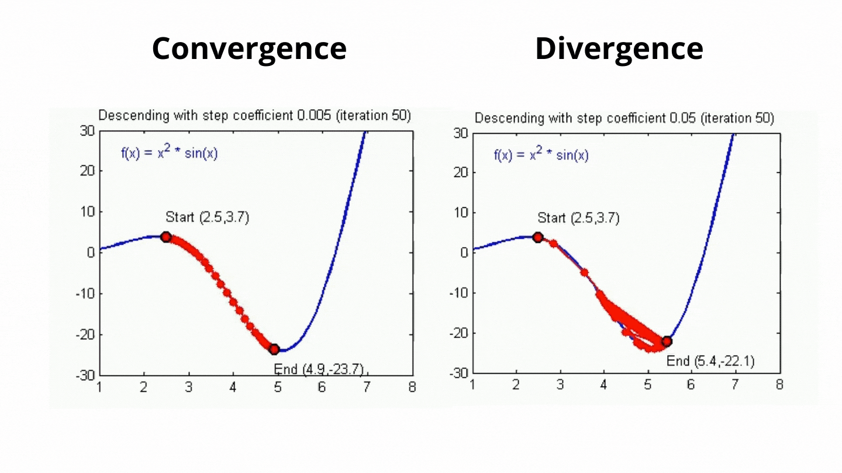
Learning Rate
Learning rate controls how much the parameters are adjusted based on the gradients of the loss function.
https://towardsai.net/

Slide 8
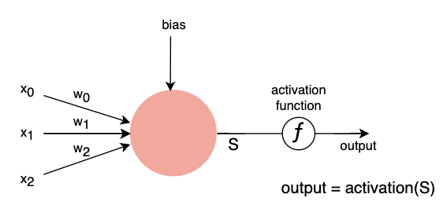
Activation Function
Activation functions are important in machine learning because they introduce nonlinearity, allowing models to learn complex patterns and make non-linear predictions. They also help propagate gradients during training and control the output range of the model for better interpretation and performance.

Slide 9

Activation Functions

Slide 10
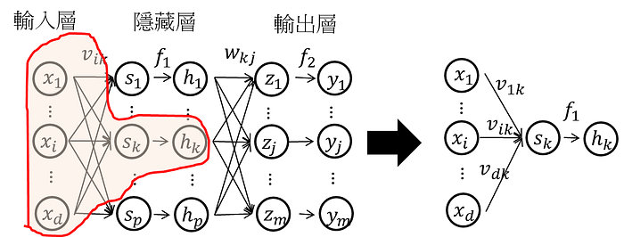
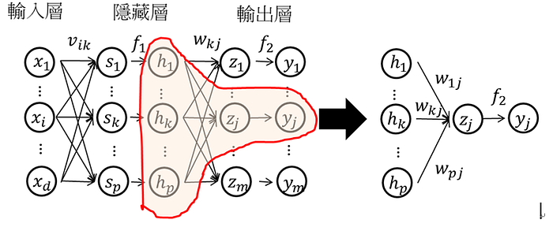
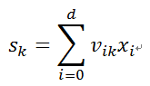
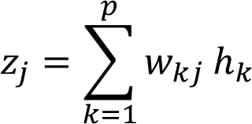
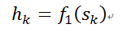
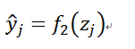
Forward Propagation
Through activation function
Output =

Slide 11
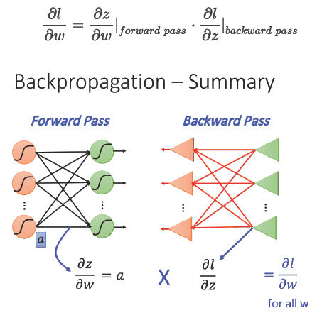
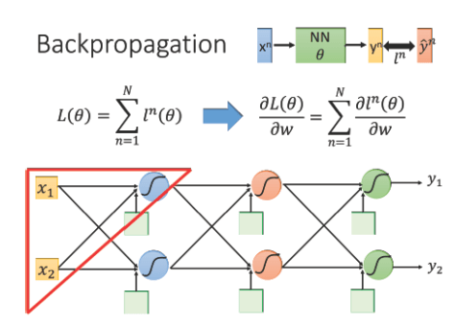
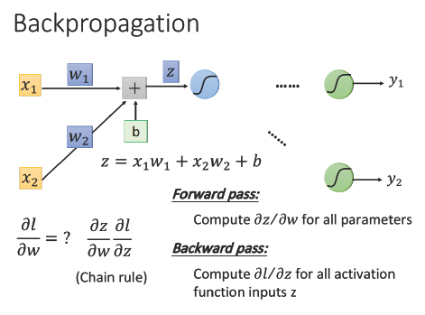
Backward Propagation
Notes:
loss function: L(θ) 等於所有的training data的loss總和
Forward pass 每一個neuron 的activation function 的output，就是他所連結的weight 的 ∂z/∂w
Backward pass 建一個與原來方向相反的neural network，它的三角形neuron的output 就是 ∂l/∂z，把通過forward pass 得到的 ∂z/∂w 和通過backward pass 得到的 ∂l/∂z 乘起來就可以得到 l 對 w 的偏微分 ∂l/∂w

Slide 12
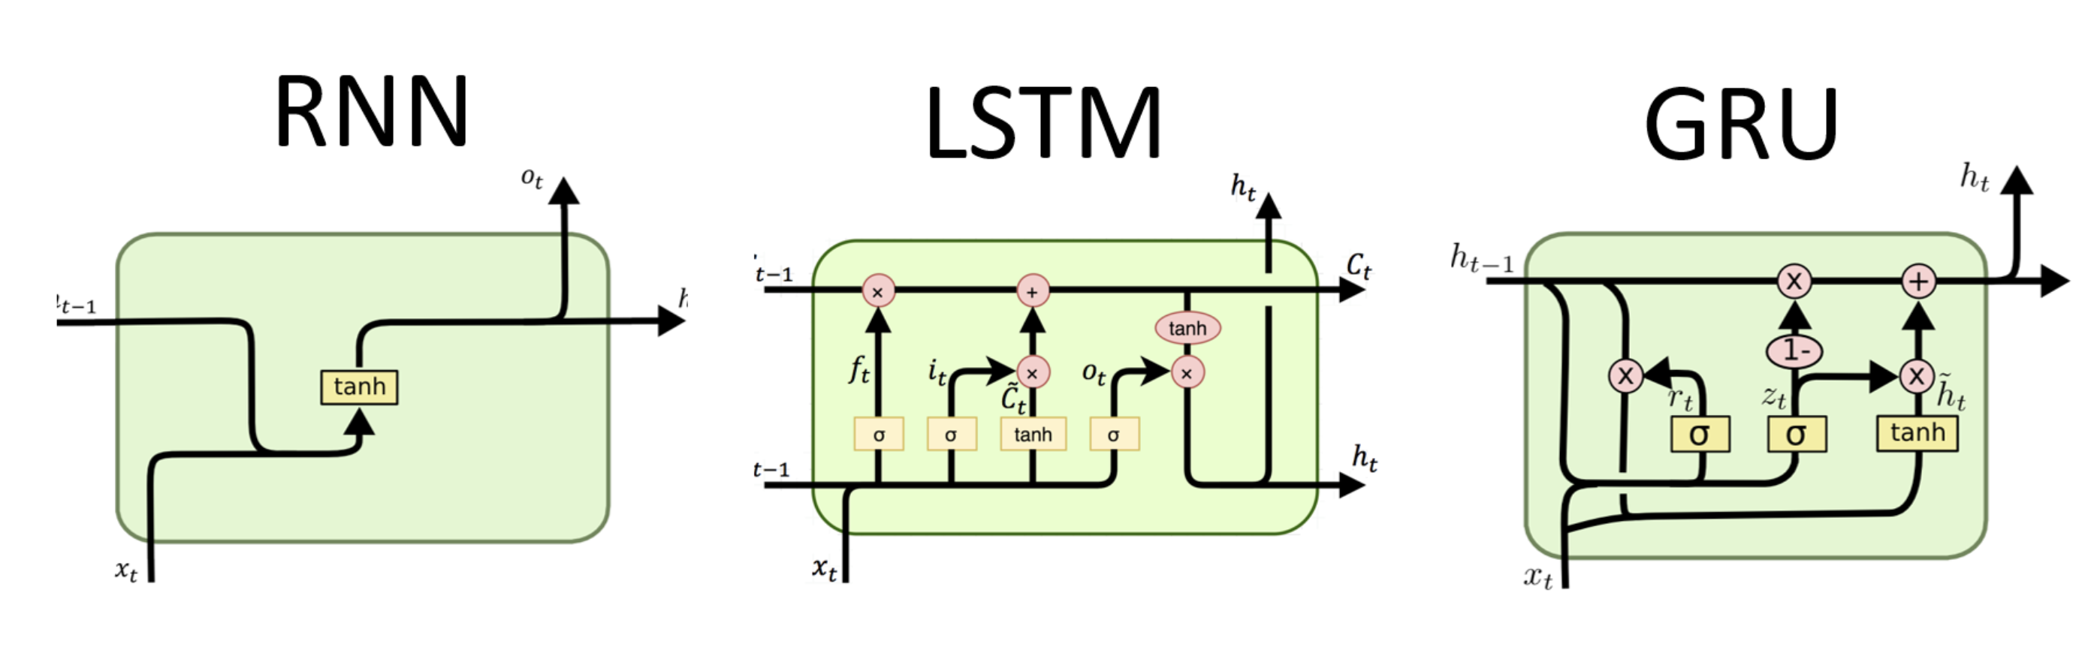
Recurrent Neural Network (RNN)
RNN : Mostly used in language model, speech recognition, RNNs have feedback connections, which allow them to maintain an internal memory of past computations, making them capable of handling sequences of arbitrary length

Slide 13

Convolutional Neural Network(CNN)
CNN : Used in image classification, object detection. It utilizes convolutional layers, which apply filters to input data to extract relevant features. By using shared weights and pooling operations, CNNs can capture spatial hierarchies and learn patterns at different scales

Slide 14
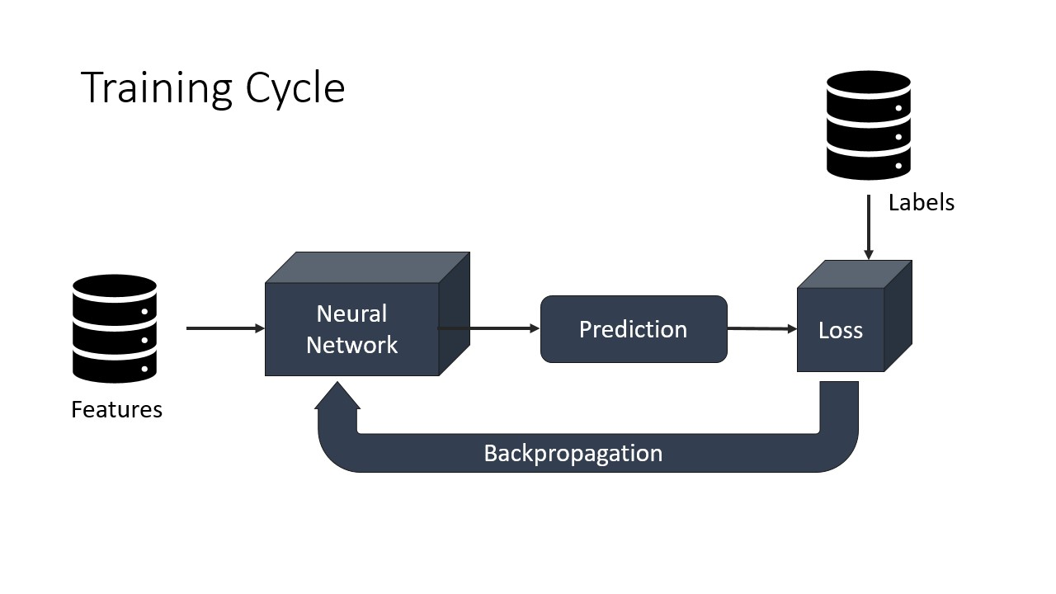
Interactive
Go to Exercise 2
Sbatch submit_training.sh
Training a model to predict molecules property
Follow slurm output by tail -f to see what’s happening.

Slide 15
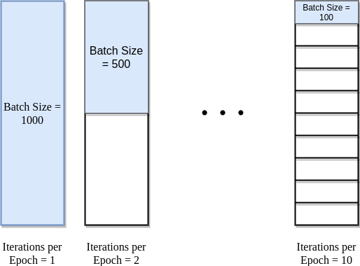
Details about training model
Dataset size = Iteration * Batch size （1 Epoch）Iteration = （Data set size / Batch size）* Epoch

Slide 16
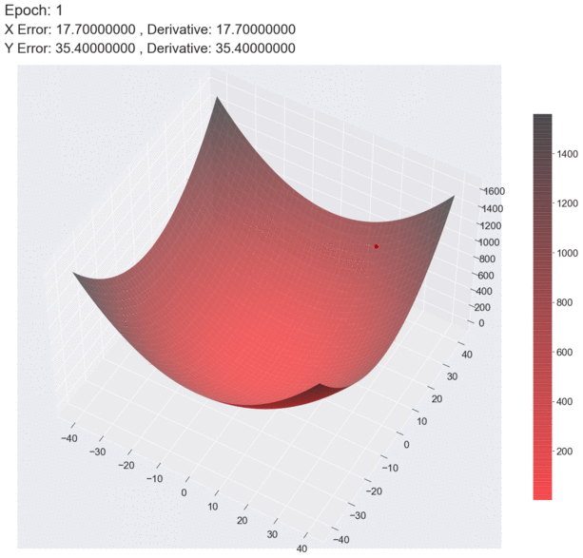

How batch size effect gradient descent
Batch size = 10
Batch size = 1
https://medium.com

Slide 17
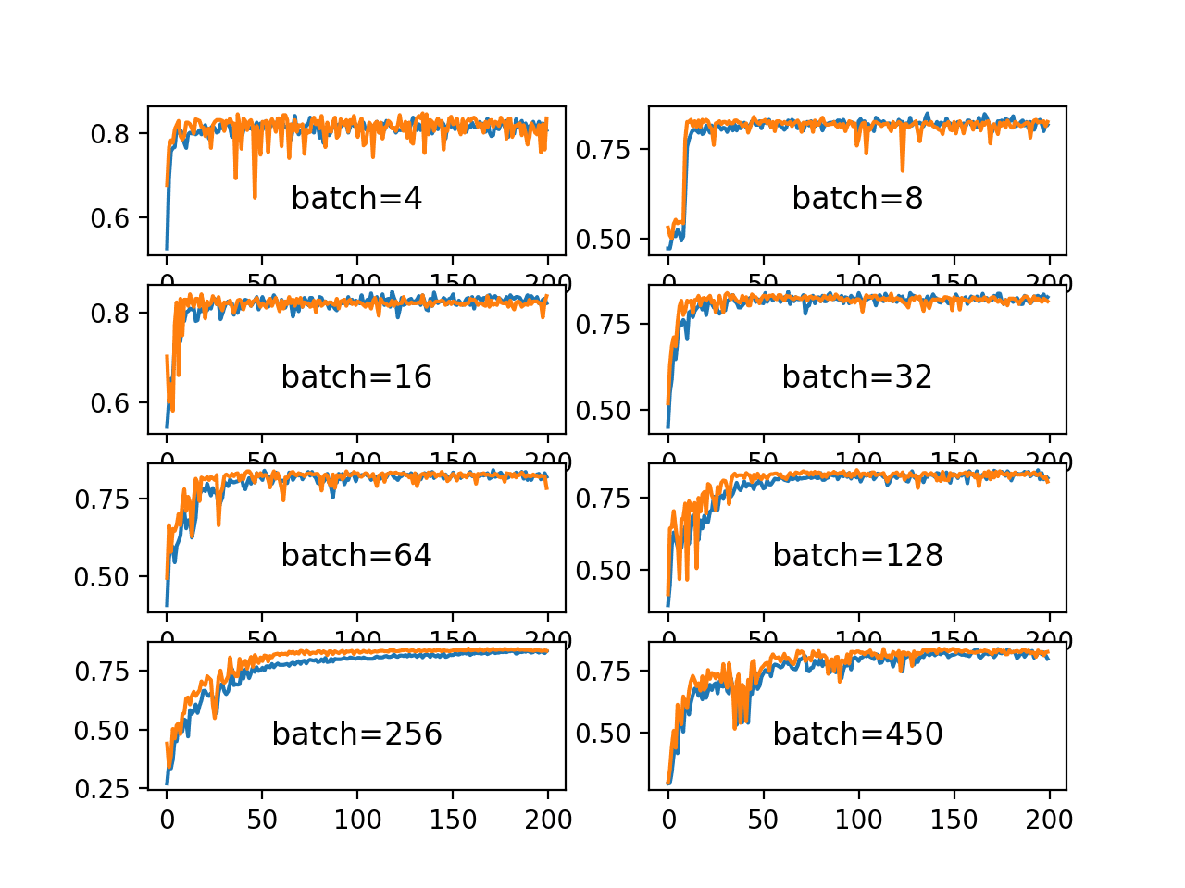
Is larger batch size always perform well?
Large batch size Advantages : provide smoother and more stable gradients, which can facilitate convergence. Large batch size
Disadvantages: Reduce the randomness in each iteration during training, which can affect the model's generalization ability.

Slide 18
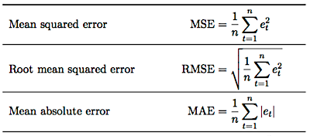
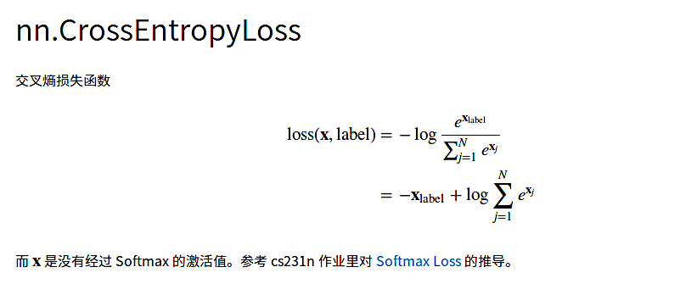
Loss Function
For regression case
For classification case

Slide 19
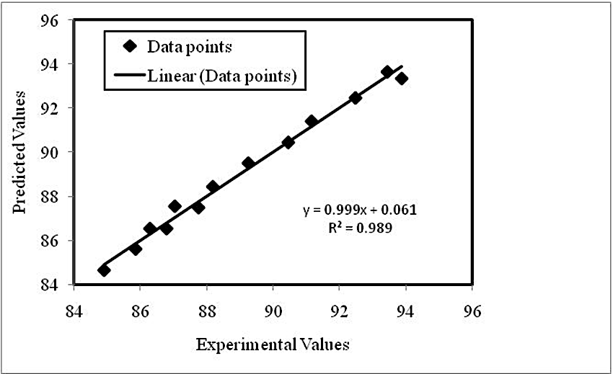

Parity plot
A parity plot is a scatterplot that compares a set of results from a training model against ground truth data. Each point has coordinates (x, y), where x is a true value and y is the corresponding value from the model.

Slide 20
Interactive
Go to Exercise 3
Click parity_plot.ipynb
Run kernel
Shown the parity of model prediction with ground truth
Analyzed the rmse loss and mae loss of model performance

Slide 21
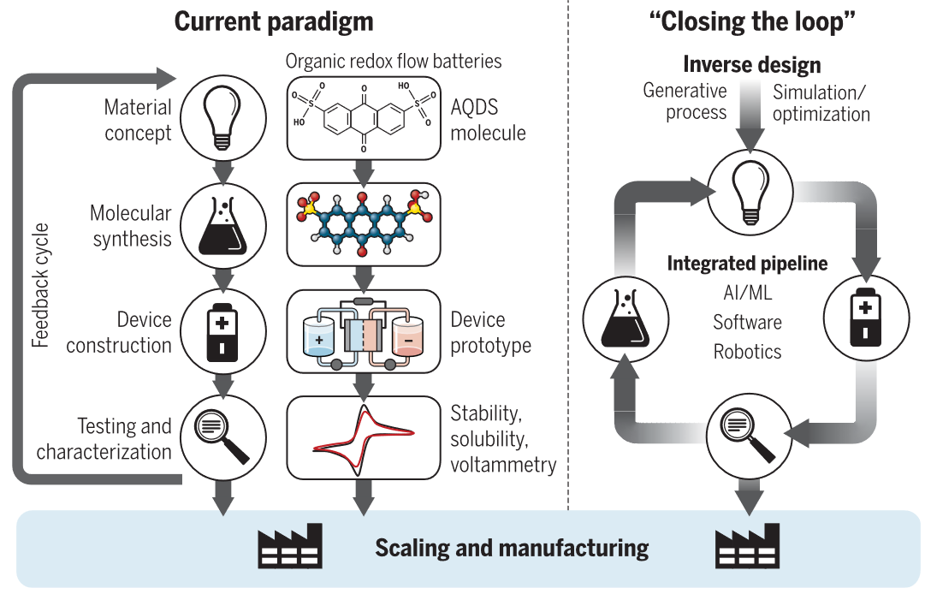
Generative models
Sanchez-Lengeling, B.; Aspuru-Guzik, A. Inverse Molecular Design Using Machine Learning: Generative Models for Matter Engineering. Science 2018, 361, 360

Slide 22
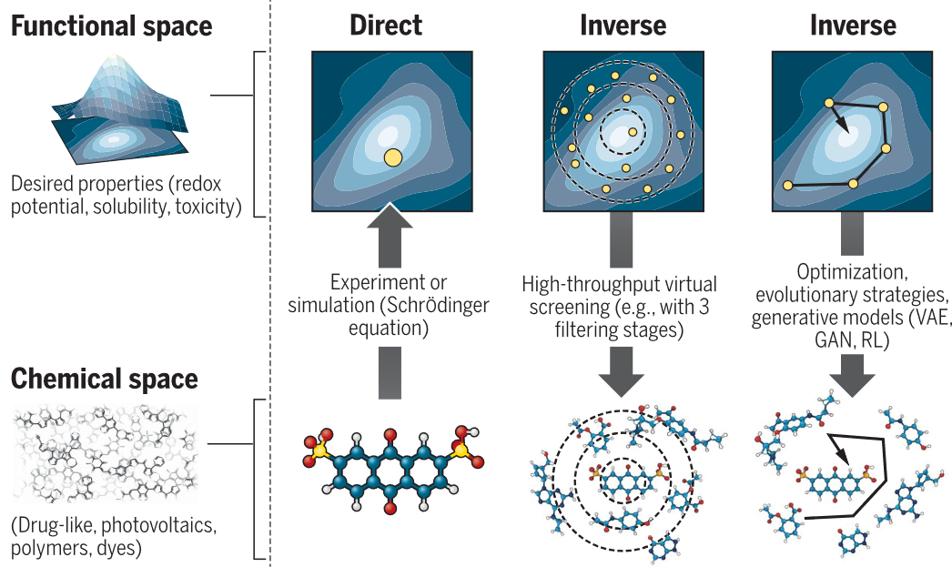
Generative models
Sanchez-Lengeling, B.; Aspuru-Guzik, A. Inverse Molecular Design Using Machine Learning: Generative Models for Matter Engineering. Science 2018, 361, 360

Slide 23
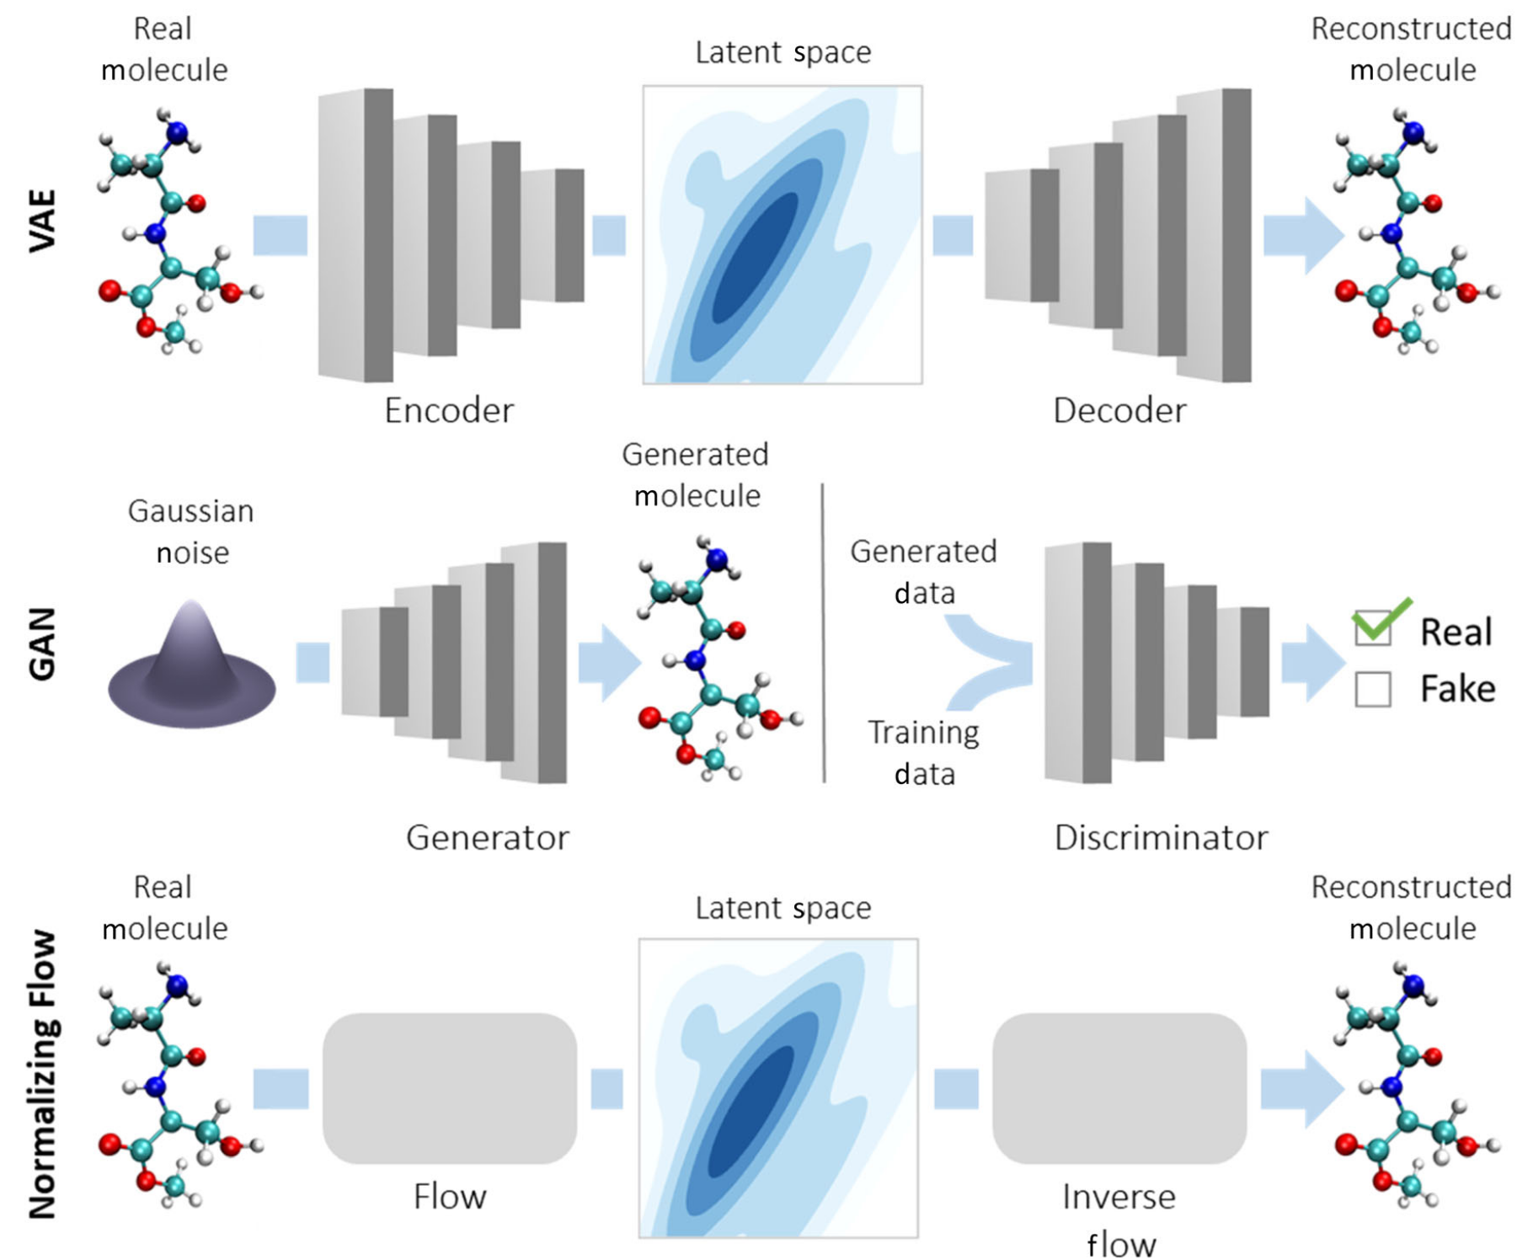
Generative models
Bilodeau, C.; Jin, W.; Jaakkola, T.; Barzilay, R.; Jensen, K. F.; Klavs Jensen, C. F. Generative Models for Molecular Discovery: Recent Advances and ChallengesMachine Learning. 2022.

Slide 24
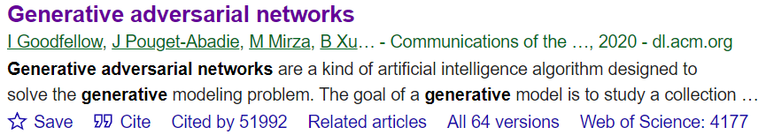
Generative Adversarial Networks (GAN)
Goodfellow, I. J.; Pouget-Abadie, J.; Mirza, M.; Xu, B.; Warde-Farley, D.; Ozair, S.; Courville, A.; Bengio, Y. Generative Adversarial Networks. arXiv June 10, 2014. https://doi.org/10.48550/arXiv.1406.2661.

Slide 25
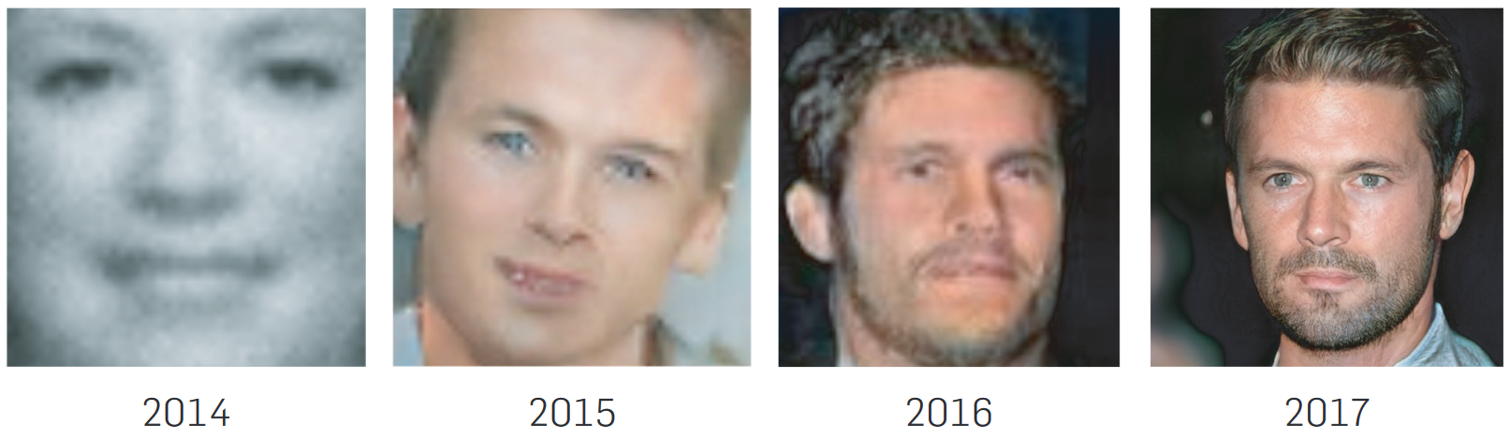

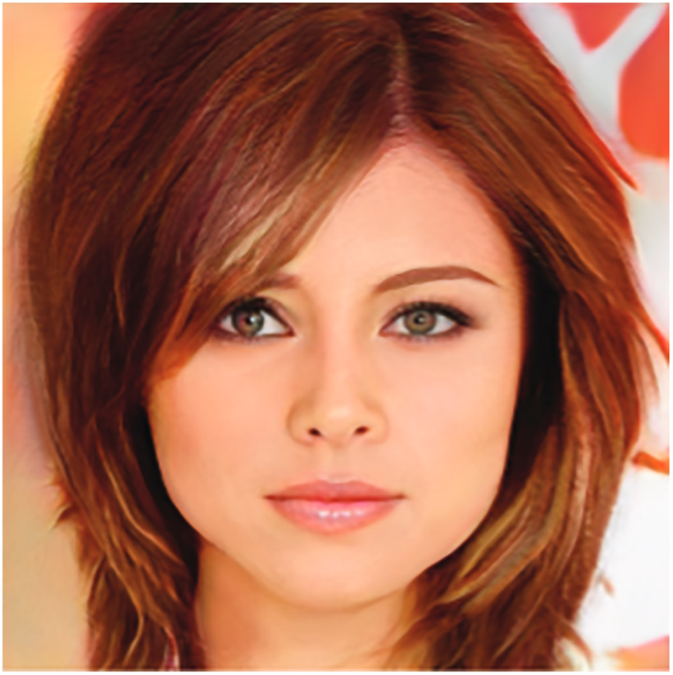
Generative Adversarial Network (GAN)
Goodfellow, I.; Pouget-Abadie, J.; Mirza, M.; Xu, B.; Warde-Farley, D.; Ozair, S.; Courville, A.; Bengio, Y. Generative Adversarial Networks. Commun. ACM 2020, 63, 139

Slide 26
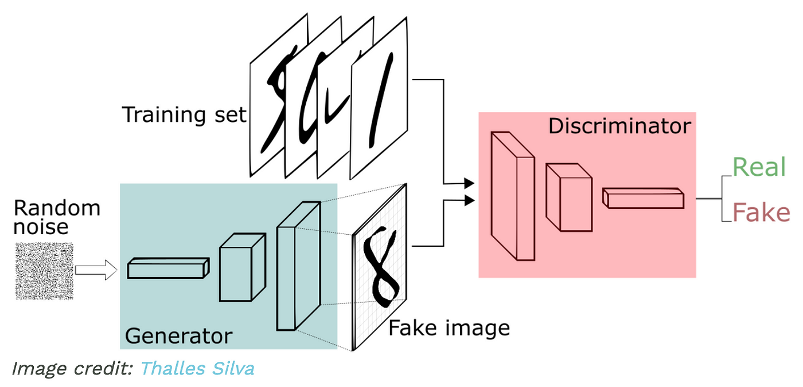
Generative Adversarial Network (GAN)
GAN : The core idea of a GAN is based on the "indirect" training through the discriminator, another neural network that can tell how "realistic" the input seems, which itself is also being updated dynamically. GANs are used for generating synthetic data that resembles a specific input dataset

Slide 27
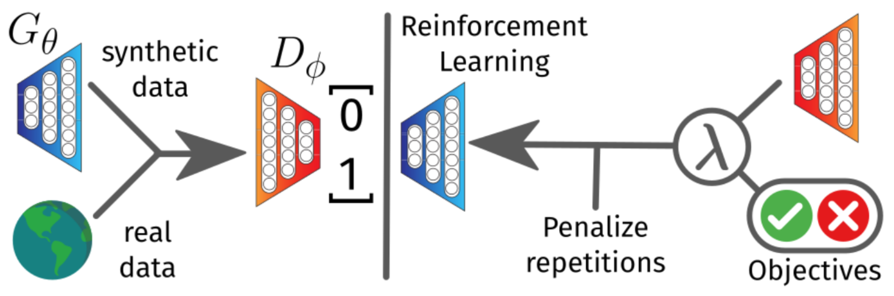
Objective-Reinforced Generative Adversarial Networks (ORGAN)
Gθ is a RNN with LSTM cells trained on ZINC database
Dφ is Convolutional Neural Network (CNN) for text classification tasks
Guimaraes, G. L.; Sanchez-Lengeling, B.; Outeiral, C.; Farias, P. L. C.; Aspuru-Guzik, A. Objective-Reinforced Generative Adversarial Networks (ORGAN) for Sequence Generation Models. arXiv February 6, 2018. https://doi.org/10.48550/arXiv.1705.10843.

Slide 28
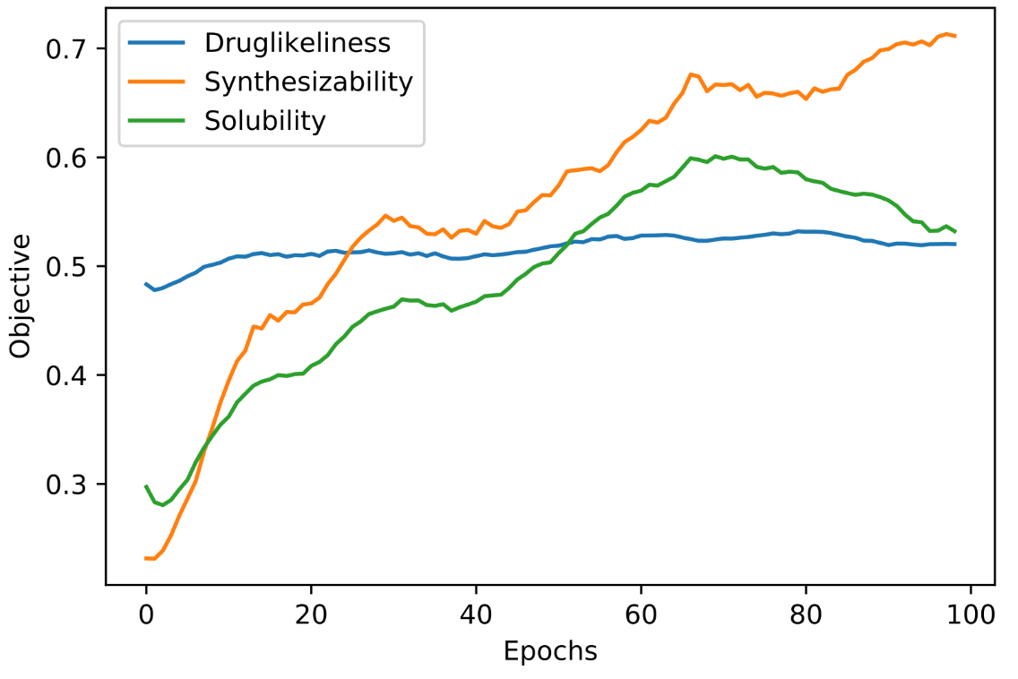
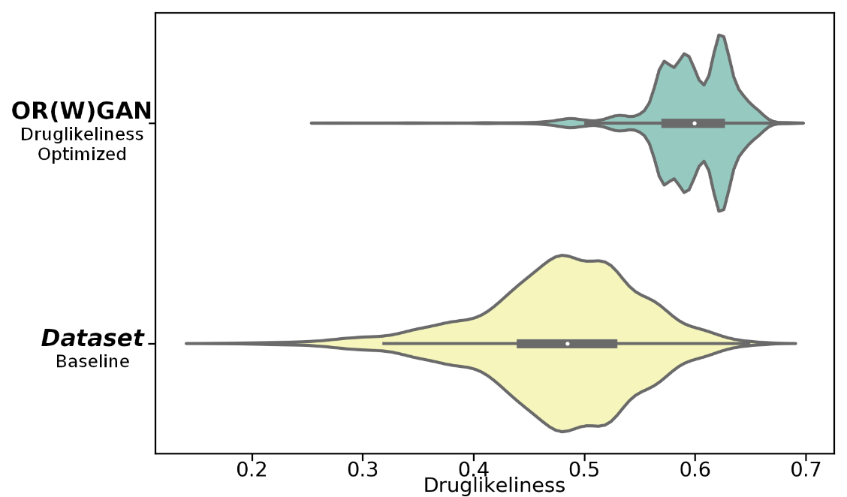
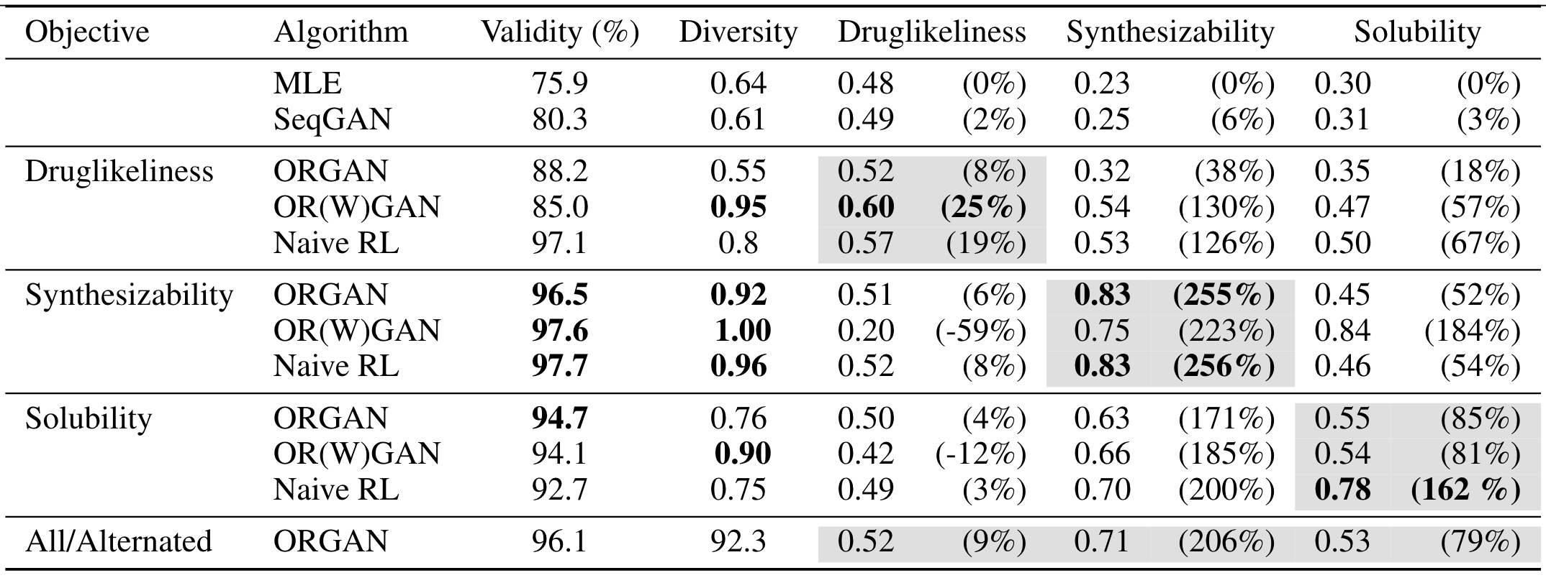
GAN for molecule design
N = 5440
N = 5000
Guimaraes, G. L.; Sanchez-Lengeling, B.; Outeiral, C.; Farias, P. L. C.; Aspuru-Guzik, A. Objective-Reinforced Generative Adversarial Networks (ORGAN) for Sequence Generation Models. arXiv February 6, 2018. https://doi.org/10.48550/arXiv.1705.10843.
Notes:
W = the Wasserstein variant

Slide 29
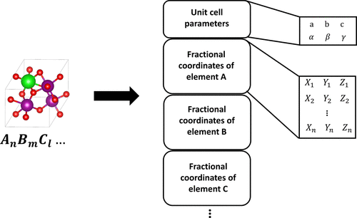
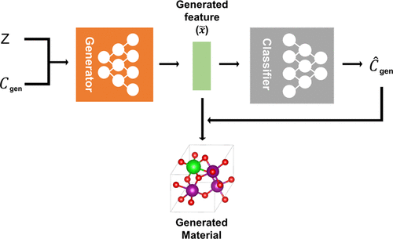
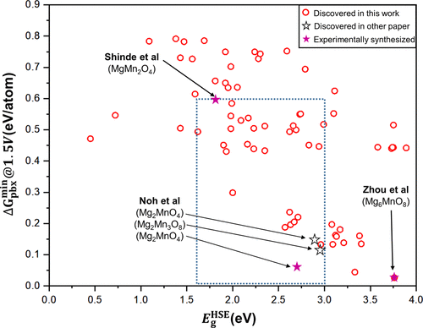
GAN for generating crystal structure
Kim, S.; Noh, J.; Gu, G. H.; Aspuru-Guzik, A.; Jung, Y. Generative Adversarial Networks for Crystal Structure Prediction. ACS Cent. Sci. 2020, 6, 1412

Slide 30
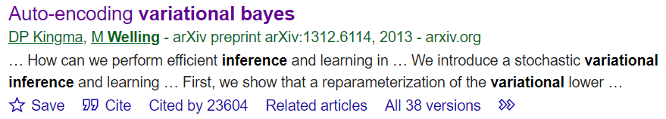
Variational Autoencoder

Slide 31
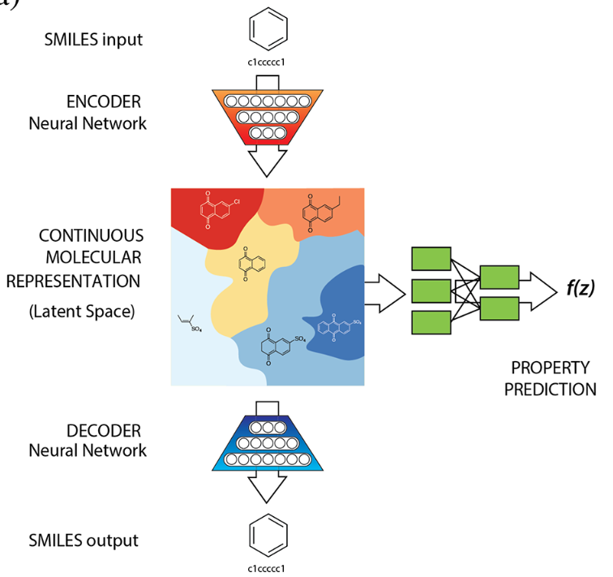
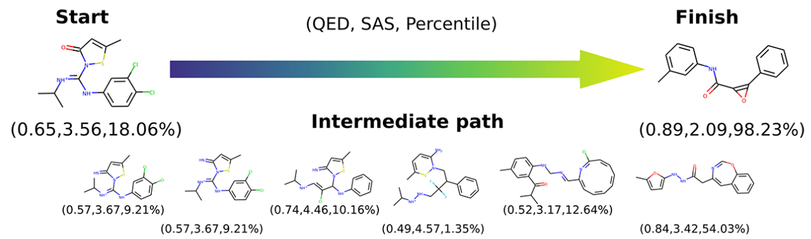
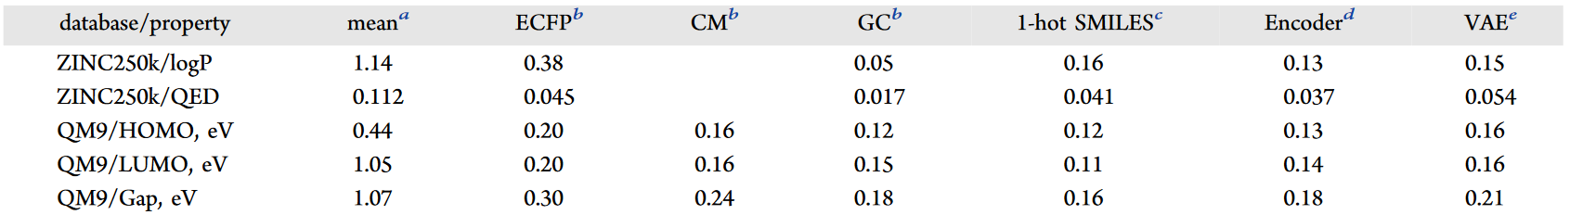
VAE for molecule design
Gómez-Bombarelli, R.; Wei, J. N.; Duvenaud, D.; Hernández-Lobato, J. M.; Sánchez-Lengeling, B.; Sheberla, D.; Aguilera-Iparraguirre, J.; Hirzel, T. D.; Adams, R. P.; Aspuru-Guzik, A. Automatic Chemical Design Using a Data-Driven Continuous Representation of Molecules. ACS Cent. Sci. 2018, 4, 268

Slide 32
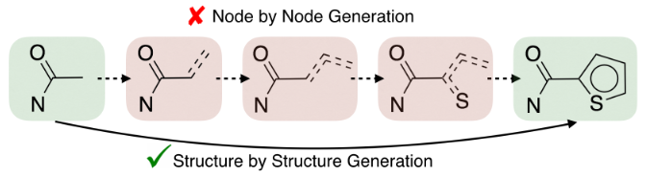
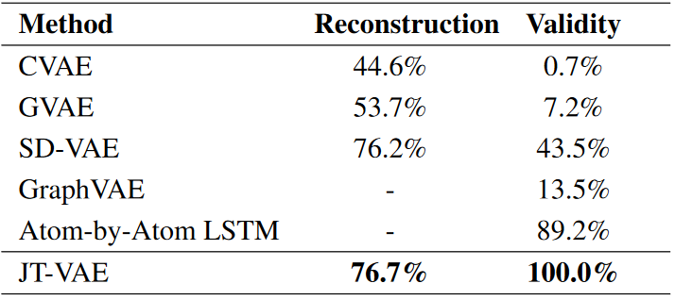
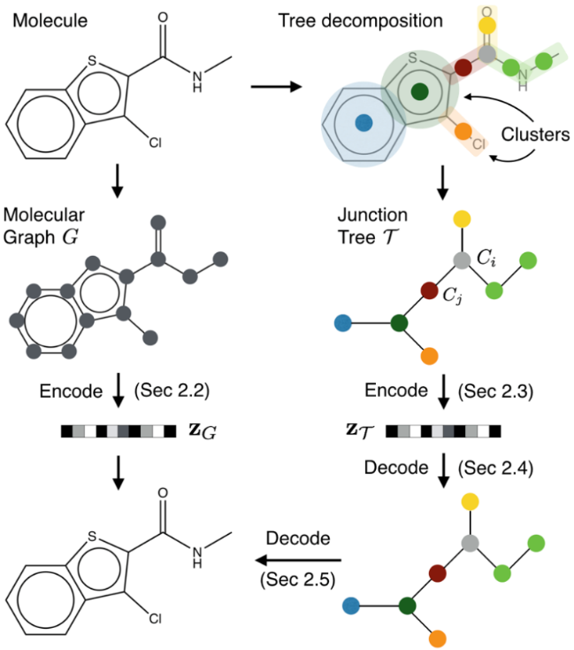
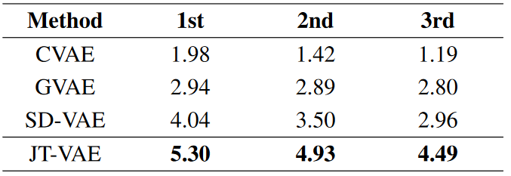

VAE for molecule design
Jin, W.; Barzilay, R.; Jaakkola, T. Junction Tree Variational Autoencoder for Molecular Graph Generation. arXiv March 29, 2019. https://doi.org/10.48550/arXiv.1802.04364.

Slide 33

Interactive
Go to Exercise 4
Click Generatesample.ipynb
Run kernel
Assign a smiles string that model can generate similar molecule
Run kernel
Model generate nearby molecule

